Slide 1
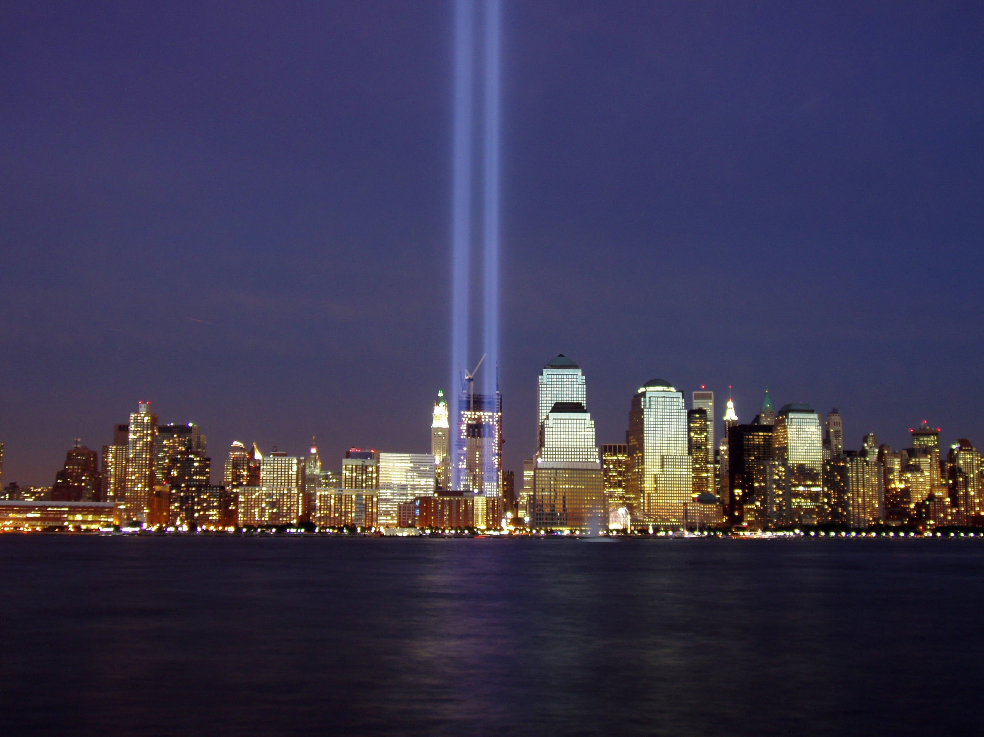
September 11th Attacks
By: Jacob Wall

Slide 2
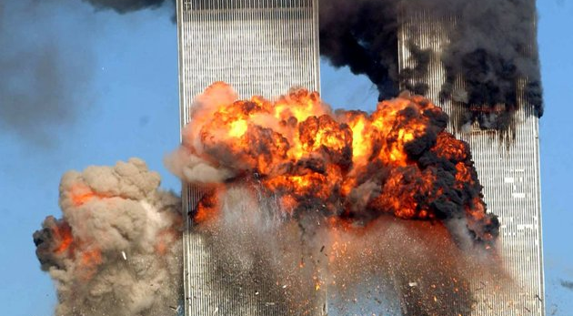

Slide 3
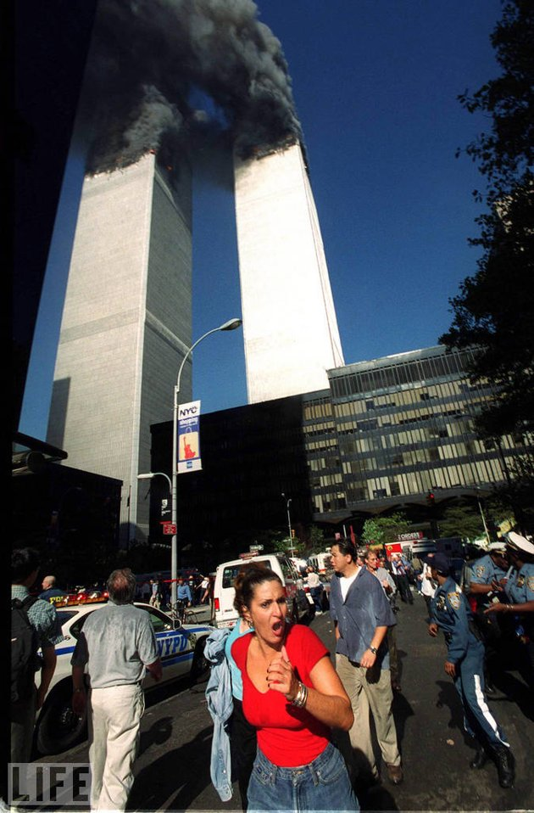

Slide 4
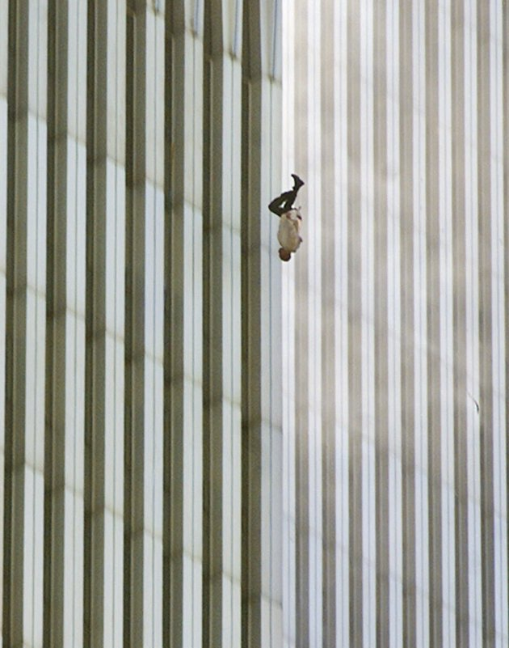

Slide 5
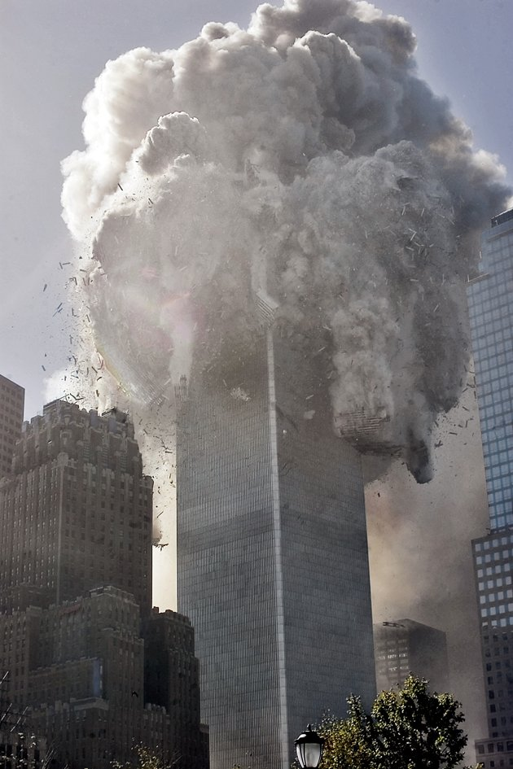

Slide 6
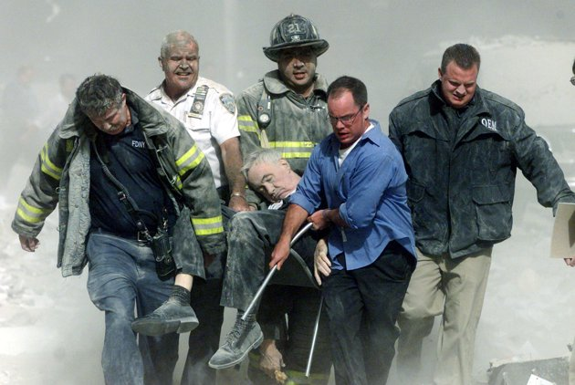

Slide 7
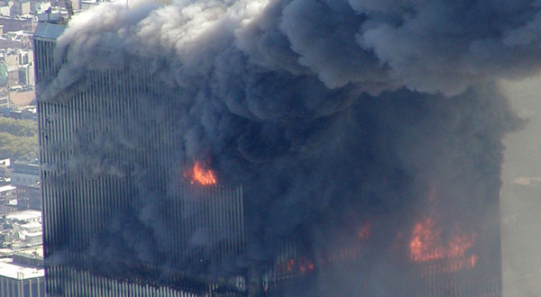

Slide 8
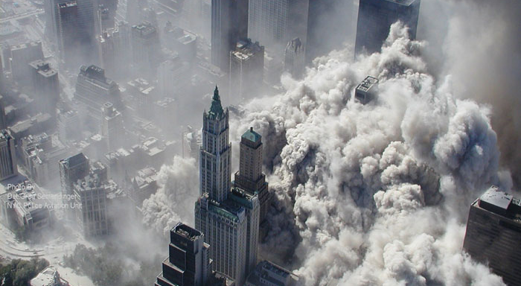

Slide 9
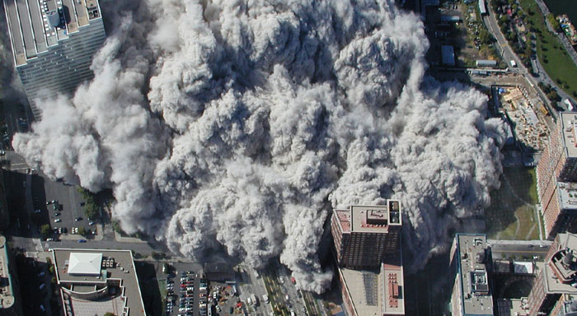

Slide 10
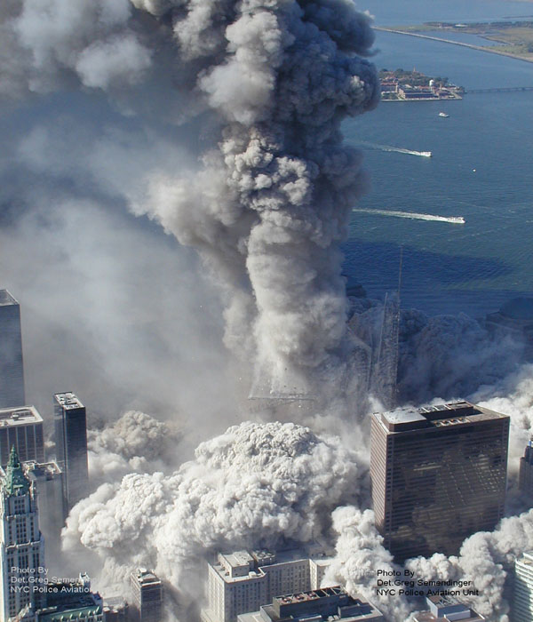

Slide 11
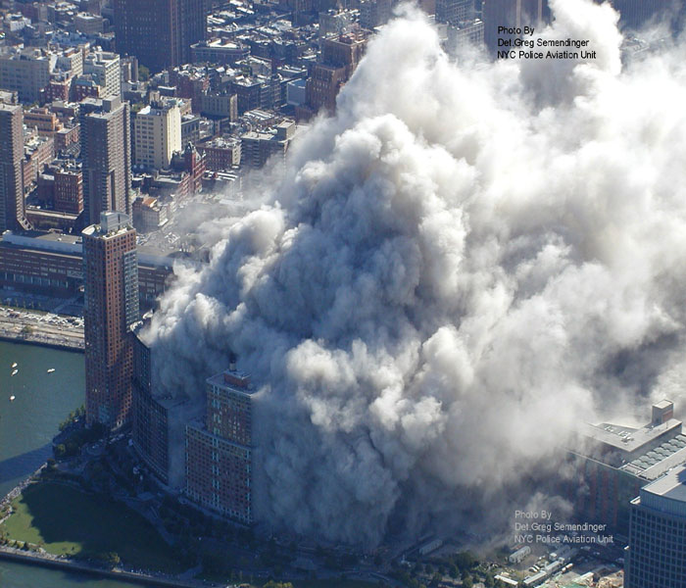

Slide 12
One day…
One terrorist organization
Nineteen hijackers
Four airplanes
2,996 Dead
One war
Immediate social change
A day no one will forget

Slide 13
Premise of the attacks
The attacks were on the the following three premises:
Financial
Military
Government

Slide 14
Financial
The World Trade Center’s were the financial capital of America.
The immediate loss of the towers would not only be iconic but would result in the loss of major financial institutions ability to conduct business

Slide 15
Financial
Major exchanges relied on the WTC’s to be a core part of business.
The exchanges stopped trading between September 11, 2011 and September 17, 2011, the longest shutdown in almost a decade.
1.4 trillion dollars were lost on the stock market in the week after the stock market reopened representing a loss of 14% for the NYSE and 11.6% for the S&P 500 or to put it into perspective nearly 14% of our GDP back in 2001.

Slide 16
Financial
$40.1 billion was paid out by insurance companies.
The economy just started a recession in April of 2001 so with the attacks it made it all that much worse.

Slide 17
Military
The Pentagon is an icon of the United States of America’s strong military presence.

Slide 18
Government
The intended target for United Flight 93 was for the Capitol. The Capitol is, like the Pentagon, iconic for our strong Government.

Slide 19
How is 9/11 important to society?
9/11 changed the mindset of American’s from a “care-free” and “trusting” country to one focused on security more than ever.
Increased security at airports
Any suspicious activity is immediately investigated
Patriot Act

Slide 20
Increased security at airports
Requirement of government ID
Secondary screening
Pat downs
Dogs at airports
Increased use of air marshals

Slide 21
Patriot Act Explained

Slide 22
Patriot Act – Title I
Boosted budgets used towards preventing terrorism
Established funds to be used towards counter terrorism
Allowed the FBI to expand the FBI’s Technical Support Center

Slide 23
Patriot Act Title II
Allows intelligence to be gathered without court orders
Telephone, email and financial documents can be accessed without court orders
Property can be seized if the owner is believed to be part of a terrorist organization

Slide 24
Patriot Act Title III
Anti-money laundering
Requires financial institutions to receive and hold copies of more documents to prevent money laundering and verify the identity of the owner

Slide 25
Patriot Act Title IV
Increased border security
Made getting visa’s much harder

Slide 26
Patriot Act Title V
Created higher rewards for tips on terrorism

Slide 27
Patriot Act Title VI
U.S. Victims of Crime Fund was modified to allow for a quicker and bigger disbursement for victims and families of victims of terrorism.

Slide 28
Patriot Act Title VII
Increased the ability of law enforcement to act on terrorist activity that occurs across jurisdictional lines.

Slide 29
Patriot Act Title VIII
Redefined “terrorism”
Created harsher punishments for cyber-terrorism

Slide 30
Patriot Act Title IX
Redefined how information is shared within agencies

Slide 31
Patriot Act Title X
Increased requirements for licenses of those who carry and/or transport hazardous materials
Increased Drug Enforcement Administration budget
Required more disclosure on behalf of telemarketers

Slide 32
Why is the Patriot Act so controversial?
Many people view it as an invasion of privacy, if you just so happen to come in contact with someone being investigated - your laptop, iPhone/Blackberry, etc can all be tapped into due to how Section 206 was written

Slide 33
Why is the Patriot Act so controversial?
Many view it as unconstitutional and violating the Fourth Amendment, which guards against unreasonable searches and seizures.

Slide 34
Why is the Patriot Act so controversial?
Very little oversight to execute acts that many would deem invasive to their privacy was built into the act.

Slide 35
How is 9/11 important to politics?
9/11 became a commonplace within politics, even outside of the creation of the Patriot Act
Became the starting topic when speaking about anti-terrorism
The subsequent War on Terrorism rose government expenditure in defense causing a budget defici

Slide 36
How is 9/11 important to culture?
The effects of 9/11 are still felt over ten years later
We see the effects of 9/11 in nearly day to day life from political campaigns, TV, and on the internet.

